Slide 1

Who dominates the Council of Bogotá and how?
Leonardo Montero, Daniel Ayala, Vivian Aranda
{l.montero, jd.ayala, vl.aranda140}@uniandes.edu.co
Visual Analytics (ISIS 4822) - Fall 2017
Universidad de los Andes, Bogotá, Colombia

Slide 2
WHAT: Data Abstraction
Dataset:
In order to display our visualizations, Mr. Diego Laserna (our sponsor) gave us a dataset with all information related to Council of Bogotá election results 2015. This dataset don’t include null votes, white votes and invalid votes.
The he send us an e-mail with data from election results 2011, with more granularity level than 2015.
Dataset type: table.

Slide 3
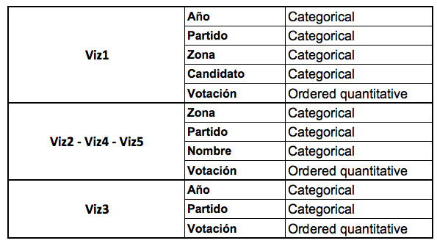
WHAT: Data Abstraction
Main Attributes:

Slide 4
WHY: Task Abstraction
Dataset available encourages us to define tasks in abstract form,
rather than the domain-specific way that users typically think
about them. According this, we decide to lead our approach in next sense:
To deploy which was the distribution of election results in a geographical context.
To compare the results in different scenarios: Candidate vs Candidate, Candidate per region.
Which were the candidates more similar to me?
Which candidate is most closely match up with?
Where do I must reinforce my electoral strategy?

Slide 5
WHY: Task Abstraction
Specific Tasks:
T1: As a candidate where should I focus my next campaign?
T2: Identify other candidates similar to me that obtained more votes than me.
T3: Compare results between candidates from different periods and party.
T4: Present the difference of results by locality by candidate between 2011 and 2015.
T5: Locate the area where a political party is strongest.

Slide 6
WHY: Actions
Viz1: Analyze-Consume-Present / Search – Lookup / Compare: T3
Viz2: Analyze-Consume-Present / Search – Lookup / Compare: T4
Viz3: Analyze-Consume-Present / Search – Browse / Summarize: T5
Viz4: Analyze-Consume-Present / Search – Lookup /Summarize: T3
Viz5: Analyze-Consume-Present / Search – Lookup /Summarize: T1
Votes Predictor! – Annotate / Compare

Slide 7
HOW?
Choropleth maps: encode. Space: use given geometry for area mark boundaries. Color: sequential segmented colormap.
Parallel coordinates: encode. using connection marks, vertical
spatial position expressing interaction location, containment
marks for coregulated region groups

Slide 8
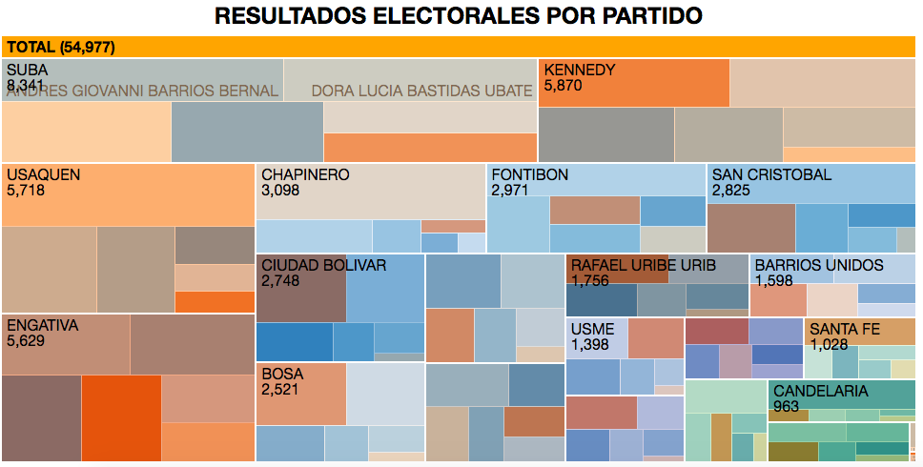
HOW?
Zoomable Treemap: Hierarchy marks – Idiom_treemap
Slope Graph: encode: arrange. Chanel: Position and angle.

Slide 9


Slide 10
Thanks!!!

